Slide 1
Chapter 4 Computer Networks – Part 2
Network media, protocols and networking standards,
networking hardware

Slide 2
Learning Objectives
Describe common types of network media
Identify protocols and networking standards
Describe networking hardware

Slide 3
Networking Media
The two general ways devices are connected to newtorks
  Wired Networking Media
  Wireless Networking Media

Slide 4
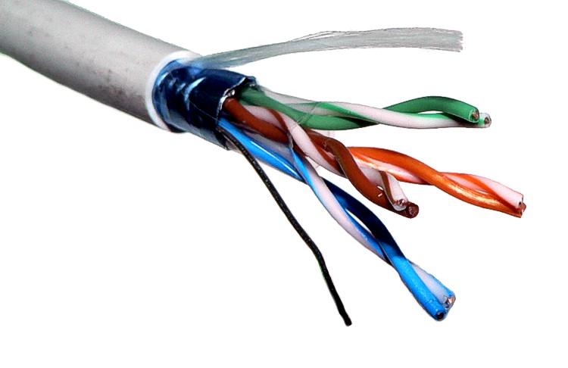
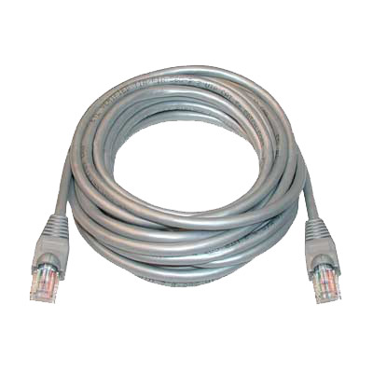
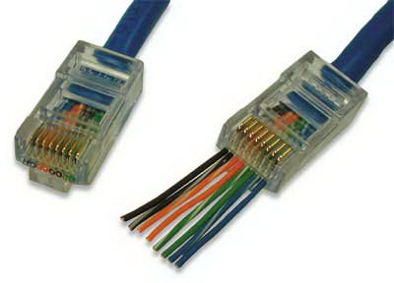
Wired Networking Media
Twisted Pair
  made up of pairs of thin strands of insulated wire twisted together.
  Rated by category
    CAT 5
    CAT 6
RJ 45 Connector

Slide 5
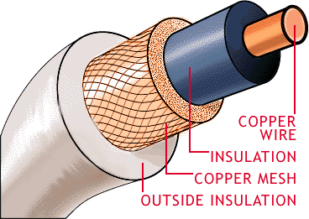
Wired Networking Media
Coaxia Cable (coax)
  coaxial cable consists of
  Blocks electromagnetic interference better then twisted pair.

Slide 6
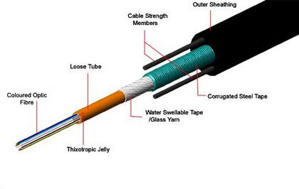
Wired Networking Media
Fiber Optic Cable
  contains multiple— sometimes several hundred— clear glass or plastic fi ber strands, each about the thickness of a hu-man hair
  cable transfers data represented by light pulses at speeds of billions of bits per second.

Slide 7
Wireless Networking Media
Wireless networks usually use radio signals to send data through the airwaves.
Other radio signal applications include
  Mobile phone
  Radio
  Television
Different applications use different frequencies to broadcast their information.

Slide 8
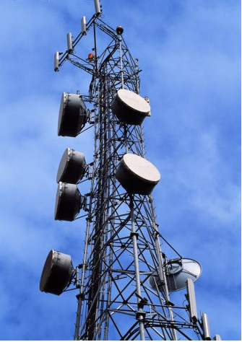
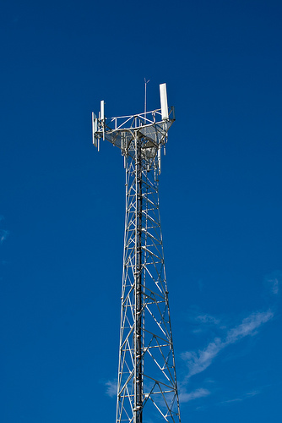
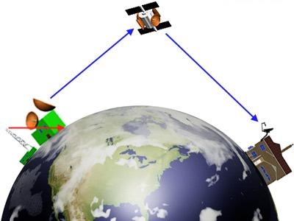
Wireless Networking Media
Cellular radio
Microwave
Satellite .

Slide 9
TCP/IC and Other Communications Protocols
A protocol is a set of rules to be followed in a specific situation.
Examples of protocols used for specific Internet applications:
  HTTP - Short for HyperText Transfer Protocol, the underlying protocol used by the World Wide Web. HTTP defines how messages are formatted and transmitted, and what actions Web servers and browsers should take in response to various commands
  HTTPS – sending data over the Internet using the Secure Socket Layer
  FTP - Short for File Transfer Protocol, the protocol for exchanging files over the Internet.
  SMTP - Short for Simple Mail Transfer Protocol, a protocol for sending e-mail messages between servers
  POP3 - POP is short for Post Office Protocol, a protocol used to retrieve e-mail from a mail server.

Slide 10
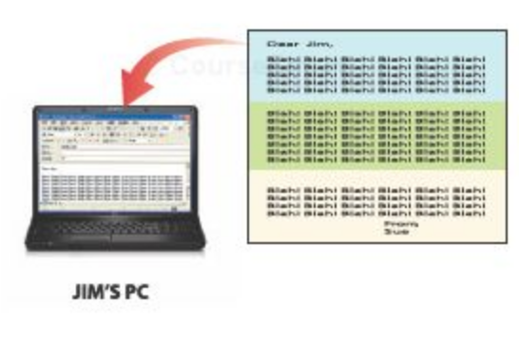
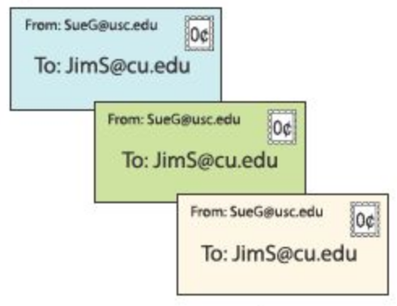
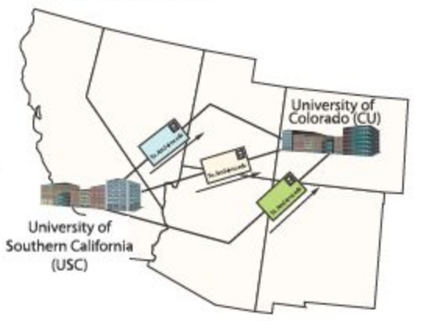
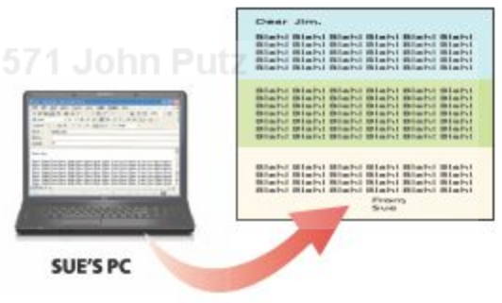
TCP/IC and Other Communications Protocols
Message is split into packets
Packets are addressed to the same destination.
Packets may travel the same or different routs to destination
Packets are reassembled into message at the destination.

Slide 11
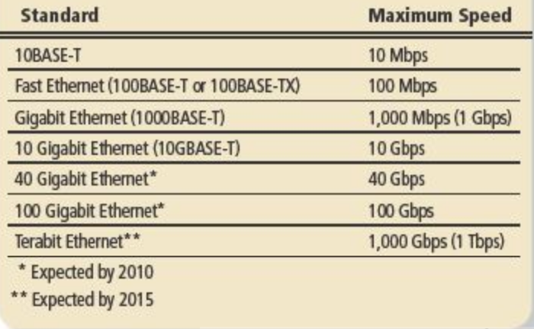
Ethernet (802.3)
Ethernet is the most widely used standard for wired networks.

Slide 12
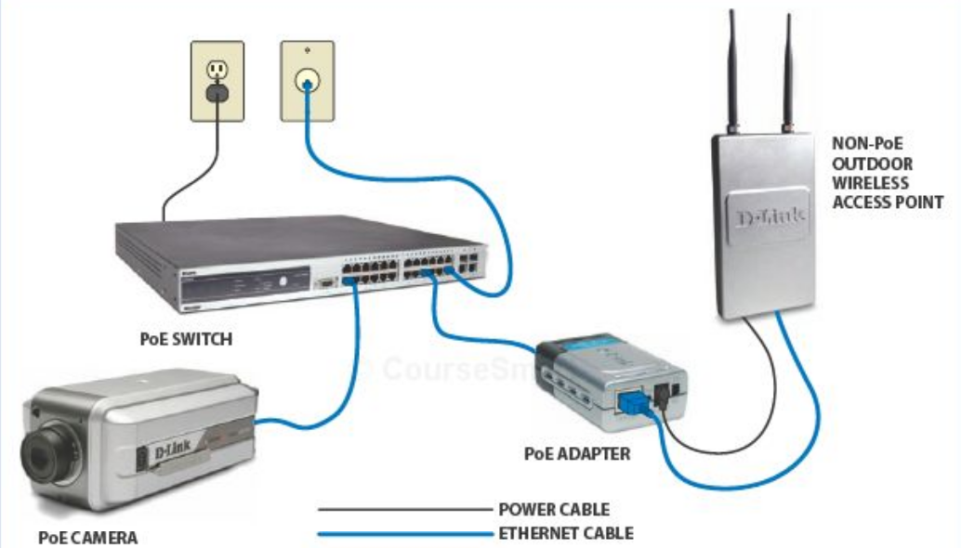
Powerline, Phoneline, G.hn, and Broadband Powerline (BPL)
Alternatives to Ethernet standard for wired home networks:
  Phoneline
  Powerline

Slide 13
Wi-Fi (802.11)
Most common networking standards used with wireless LANs is Wi- Fi ( 802.11)
A family of wireless networking standards that use the IEEE 802.11 standard.
Current standard for wire-less networks in the home or offi ce, as well as for public Wi- Fi hotspots.
Wi- Fi hardware is built into virtually all portable computers sold today.

Slide 14
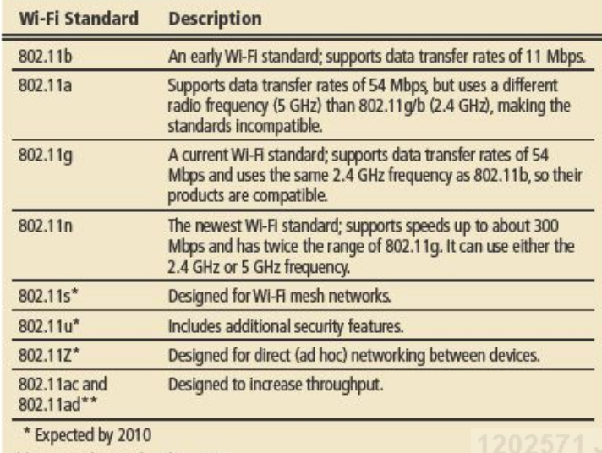
Wi-Fi (802.11)

Slide 15
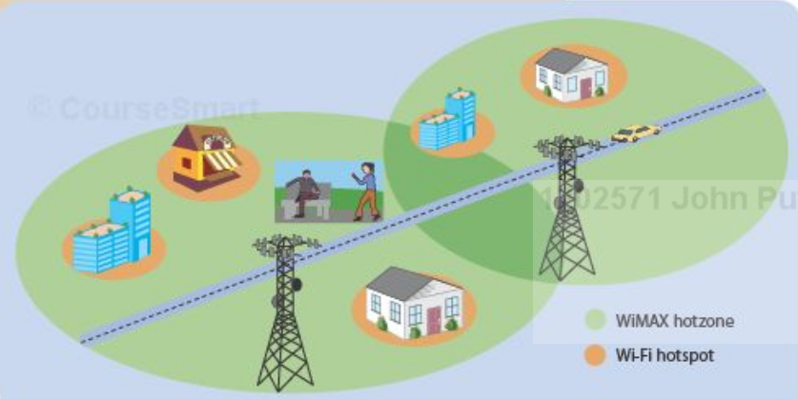
WiMAX and Mobile WiMAX
WiMAXis a series of standards designed for longer range wireless networking connections.
Mobile WiMAX is the mobile version of the WiMAX wireless networking standard.

Slide 16
Cellular Standards
Cellular standards have evolved over the years to better fulfill the demand for mobile Internet, mobile multimedia delivery, and other relatively recent mobile trends.
Current cellular standards include 3G and 3G
Personal mobile hot spots.

Slide 17
Bluetooth
a wireless standard that is designed for very short- range ( 10 meters— approximately 33 feet—or less) connections.
It is designed to replace cables between devices.
  Computers to printers
  Mobile phones to headsets
Bluetooth devices automatically recognize and network with each other when they get within transmission range.

Slide 18
Other Short-Range Wireless Standards
Wireless USB.
Ultra Wideband (UWB)
Wireless HD (WiHD)

Slide 19
Networking Hardware
Topics Covered:
  Network Adapters and Modems
  Switches, Routers, and Other Hardware for Connecting Devices and Networks
  Other Networking Hardware

Slide 20
Network Adapters and Modems
A network adapter is used to connect a computer to a network (such as a home or business network).
  network interface card (NIC) when it is in the form of an expansion card,
A modem (traditional) is used to connect a computer to a network over telephone lines.
However, in everyday use, the term modem is also used to refer to any device that connects a computer to a broadband Internet connection,

Slide 21
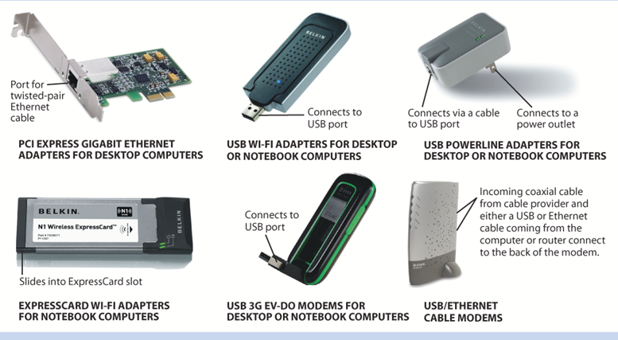
Network Adapters and Modems

Slide 22
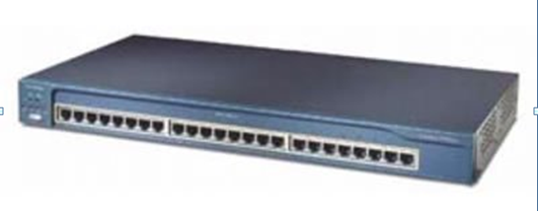
Hub, Switches, Routers
A hub transmits all data received to all network devices connected to the hub,
Original technology for networks

Slide 23
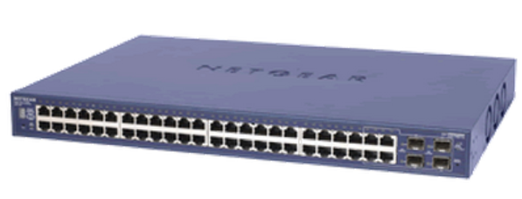
Hub, Switches, Routers
Switch contains ports to which the devices on the network connect ( typically via networking cables)
Replaces hubs in most network applicationa.
Switches identify which device connected to the switch is the one the data is intended for and send the data only to that device
switches are more efficient than hubs.

Slide 24
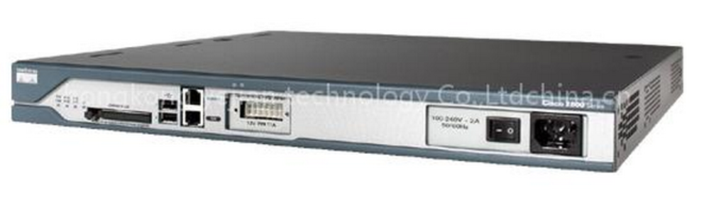
Hub, Switches, Routers
A router is used to connect multiple networks ( such as two LANs, two WANs, or a LAN and the Internet)
Routers pass data on to the intended recipient only and can plan a path through the network to ensure the data reaches its destination in the most efficient manner possible
Are used to route traffic over the Internet.

Slide 25
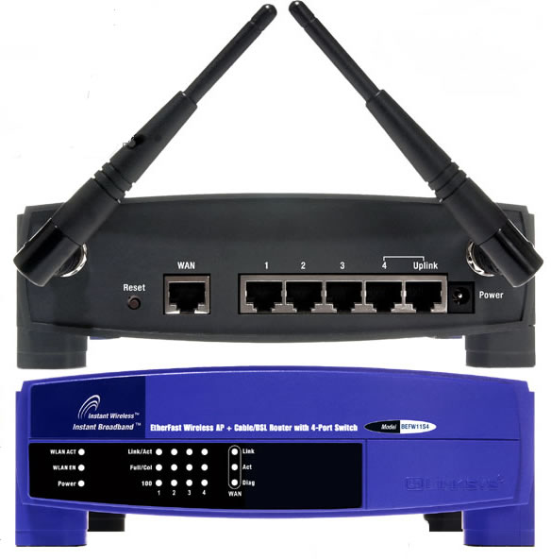
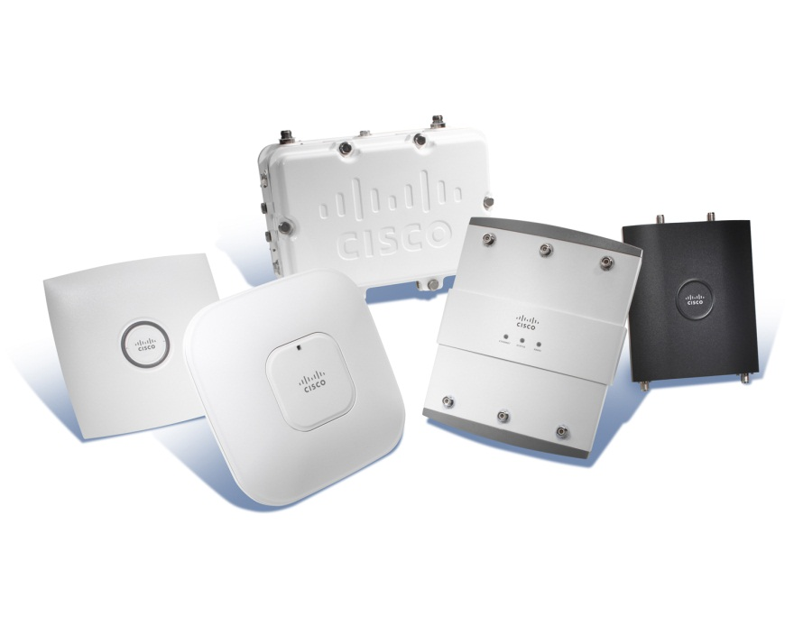
Hub, Switches, Routers
A wireless access point is a device used to grant network access to wireless client devices.
Wireless router commonly used to connect both wireless ( via Wi- Fi) and wired ( via Ethernet cables) devices to a network and to connect that network to an Internet connection.

Slide 26
Other Networking Hardware
Additional networking hardware is often needed to extend the range of a network and to share networking media:
  Repeaters - devices that amplify signals along a network.
  Range extenders - connect wirelessly to the network and repeat the wireless signal to extend coverage of that network
  Antennas
  Bridges – used to connect two LAN’s

